Slide 1
HIPAA 5010 & Web Portal Electronic Transactions Overview
Conduent
Government Healthcare Solutions

Slide 2
Purpose
The purpose of this PowerPoint is to provide an overview on, Electronic Data Interchange (EDI)/ HIPAA 5010 Transaction types, define the different 5010 transaction types, explain the EDI Transaction enrollment process, provide a summary of our EDI forms, and provide information regarding our companion guides .

Slide 3
Objectives
We will review the following:
HIPAA 5010 Transactions
835 File Example
Companion Guides
EDI Forms
5010 Transaction Enrollment

Slide 4
Introduction of HIPAA
The Health Insurance Portability and Accountability Act of 1996, known as HIPAA, was enacted on August 21, 1996, as an attempt to incrementally reform the healthcare system. The goal was to simplify and streamline the burdens of healthcare. The most widely known portion of the law is the Administrative Simplification Section which includes requirements for the following:
Standardization of electronic patient health, administrative, and financial data
Privacy
Security standards protecting the confidentiality and integrity of individually identifiable providers
Unique health identifiers for individuals, employers, health plans and health care providers

Slide 5
Why Utilize Electronic Transactions?
The push for administrative simplification originated in the health insurance industry as a way to standardize the claims processing and payment cycle, the eligibility and enrollment cycle, and even health insurers’ billing. It is important to note that HIPAA does not require physicians to conduct transactions electronically. However, if they conduct any electronic transactions, they must submit these transactions according to HIPAA standards.

Slide 6
HIPAA 5010 Transactions

Slide 7
Advantages of Using HIPAA 5010 Transactions
Using the HIPAA standard electronic transactions helps physician practices save thousands of dollars annually by using these standard transactions. The following reductions are advantages of utilizing the HIPAA standard transactions:
Costs
Overhead expenses associated with billing
Collections
Time of referral authorization
Time for verifying eligibility
Other related components of the claims management cycle

Slide 8
5010 Transactions Supported By NM Medicaid
270 - Health Insurance Eligibility Request
271 - Health Insurance Eligibility Response
276 - Health Care Claims Status Inquiry
277 - Health Care Claims Status Response
820 - Premium Payment
834 - Benefit Enrollment and Maintenance
835 - Health Care Claim Payment/Advice
837 - Health Care Claim (Professional, Institutional, & Dental)
Acknowledgement Reports
TA1 - Acknowledgement Report
999 - Acknowledgement Report (positive, negative, partial)
277CA - Claim Acknowledgement

Slide 9
5010 Transaction Definitions
270 | Health Care Eligibility, Coverage or Benefit Inquiry – Provider uses to request details of health care eligibility and benefit information or to determine if an information source organization has a particular subscriber or dependent on file.
271 | Health Care Eligibility, Coverage or Benefit Response – Payer uses to respond to 270 requests.
276 | Health Care Claim Status Request – Provider uses to request the status of health care claims.
277 | Health Care Claim Status Notification – Payer uses to respond to 276 requests.
820 | Payment Order / Remittance Advice – Insurance companies, third-party administrators, payroll service providers, and internal payroll departments use to transmit premium payment information.
834 | Benefit Enrollment and Maintenance – Benefit plan sponsors and administrators use to transmit enrollment and benefit information between each other.
835 | Health Care Claim Payment / Remittance Advice – Used by the payer and the provider to make payments on a claim, send an Explanation of Benefits (EOB) remittance advice, or to send both the payment and EOB in the same transaction.
837 | Health Care Claim – There are three (3) separate implementation guides for 837 Health Care Claims: Dental Institutional Professional Each is used by the provider- dentist/dental group, clinic/hospital, and physicians/surgeons – or between payers to submit and transfer claims and encounters to the payer.
TA1 | Interchange Acknowledgement – a standard transaction advising why an 837 claim file was rejected.
999 | Error Report- Report generated to confirm if the submitted 837 file passed standard level syntax and structure editing system and was recieved.
277CA | Claims Acknowledgement Report- Provides a claim-level acknowledgement of all claims received in the front-end processing system before claims are sent to the payer’s adjudication system.

Slide 10
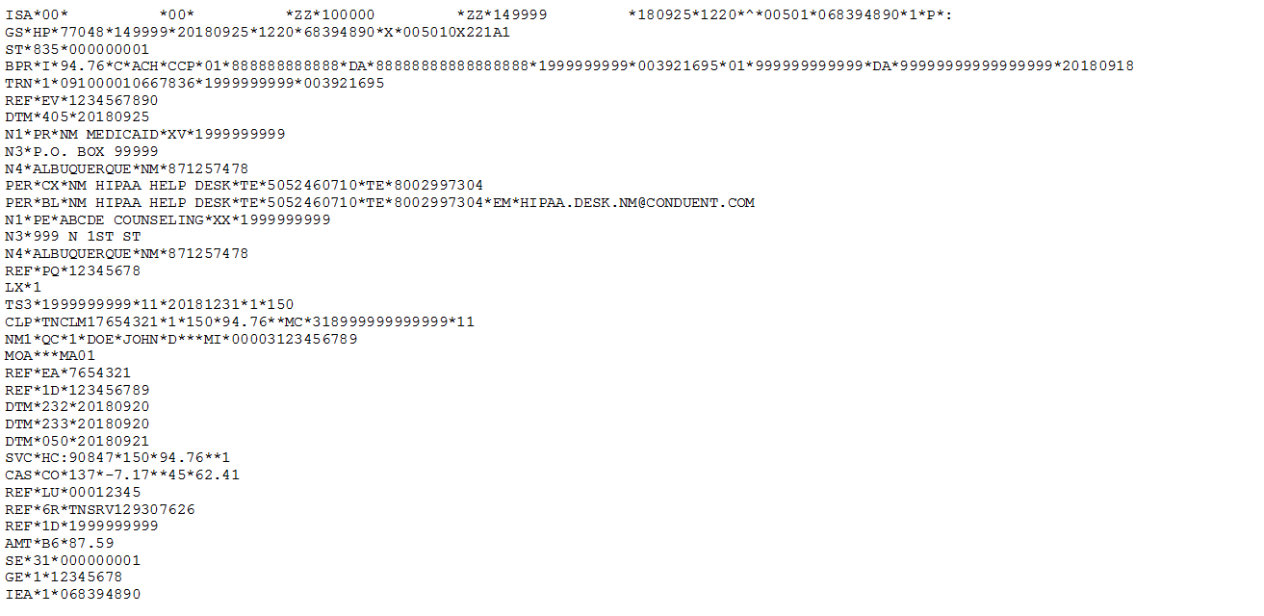
What an 835 File Looks Like
Notes:
A raw 835 file in text format. Example only.

Slide 11
Understanding the 835 Transaction File
Beginning of 835 Transaction
Transaction Identification statement
Financial information showing reimbursement amount and type of payment ( I = Information only, C=Credit, ACH = EFT payment )
EFT Number, Payer ID, and RA Number
Receiver Identification Number
835 Production Date

Slide 12
Understanding the 835 Transaction File Continued
Payer Name
Payer Address
Payer City, Stat, and Zip Code
Payer Business Contact Name (CX = Payers Claim Office, TE = Telephone Number)
Payer Technical Contact Information (BL = Technical Department, EM=Email)

Slide 13
Understanding the 835 Transaction File Continued
Payee Identification (PE = Payee, XX = NPI Number)
Payee Address
Payee City, Stat, and Zip Code
Payee Additional Identification (PQ = Billing Provider ID)

Slide 14
Understanding the 835 Transaction File Continued
Start of Claim
Provider Summary Information (NPI, Facility Code, Date, Total Claim Count, Monetary Amount)
Claim Payment Information (Patient Control number, Claim status (see below), Submitted Charges, Reimbursement Amount, Claim Filing Indicator Code (MC = Medicaid), TCN, Facility Type Code
Patient Name and Identification Number (MI = Medicaid ID)
Outpatient Adjudication Information – Claim Payment Remark Code
Other Claim Related Information (EA = Medical Record Identification Number)
Claim Status = 1
Processed as Primary
Claim Status = 2
Processed as Secondary
Claim Status = 3
Processed as Tertiary
Claim Status = 4
Denied
Claim Status = 22
Reversal of Previous Payment

Slide 15
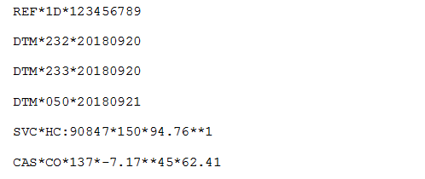
Understanding the 835 Transaction File Continued
Rendering Provider Information (1D= Medicaid Provider Number)
Service Begin Date
Service End Date
Claim Received Date
Service Payment Information (HC = HCPCS Code), Line Charge Amount, Line Reimbursement Amount, Quantity
Claim Adjustment Group Code, Claim Adjustment Reason Code, Adjustment Amount, Quantity

Slide 16
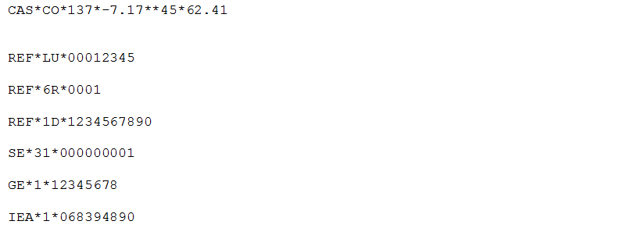
Understanding the 835 Transaction File Continued
Claim Adjustment Group Code, Claim Adjustment Reason Code, Adjustment Amount, Quantity
Service Identification (LU = Location), Billing Provider Number
Line Item Control Number
Rendering Provider Information (1D = Medicaid Provider Number)
Transaction Set Trailer
EDI Control Number
Note: For additional information regarding 835 files review the TR3 Guides (also know as Implementation Guides).
End of 835 Transaction
Notes:
Speaker notes: TR3 guides are copyrighted material and can be purchased on the X12 Store and http://store.x12.org/store/

Slide 17
Third Party Liability (TPL) / Crossover Submissions
If the Medicaid client has primary insurance, such as a TPL, other insurance or Medicare, the 837 file(s) will need to be coded with the proper data elements in order for the claim to be processed correctly by NM Medicaid. For more information on this, see the Coordination of Benefits section of the Implementation Guides
More information on the Implementation Guides (TR3s) can be found on slides 13 and 24. Additionally, information on the New Mexico Medicaid Companion Guides can be found on slides 11 -13 and slide 24 of this PowerPoint presentation. These documents can be used to configure the proper loops and segment fields of an 837 transaction.
Notes:
Under review:

Slide 18
Companion Guides

Slide 19
Companion Guides
The New Mexico Medicaid Companion Guides provide supplemental information regarding the submittal of HIPAA 5010 transactions.
Within the Companion Guides submitters can find:
A brief Navigation of the EDI Online Portal where submitters send their HIPAA 5010 files.
An overview of the testing process for submitting electronic files.
Data Clarification for segments and transactions of “business-required” data fields.

Slide 20
Companion Guides
You can obtain copies of the NM Medicaid Companion Guides on the HSD website using the following link: http://www.hsd.state.nm.us/providers/hippa-standard-companion-guides.aspx
The site contains both Fee for Service and MCO Companion Guides for each of the following transaction types:
270/271 – Benefit Eligibility Inquiry/ Member Response
276/277 – Benefit Claim Status Inquiry/ Response
835 – Health Care Claim Payment/ Advise
837D – Dental Health Care Claims
837I – Institutional Health Care Claims
837P – Professional Health Care Claims
*Please note the Companion Guides are intended for a Trading Partner to use in conjunction with the ASC X12N 5010 Implementation Guides and are not a replacement for the Implementation Guides. The TR3’s/ Implementation Guides are copyrighted material and must be purchased through the X12 store, which can be found by using the following link: http://store.x12.org/store/insurance-5010

Slide 21
EDI Forms

Slide 22
EDI Forms
The New Mexico Medicaid Web Portal contains several forms to help Trading Partners set up and manage their EDI transaction information. You can find the forms by clicking the following link: https://nmmedicaid.portal.conduent.com/static/ProviderInformation.htm#EDI
The forms available on the portal include:
EDI Provider Trading Partner Agreement.
EDI Submitter Trading Partner Agreement
EDI Authorization Form
EDI Update Form
EDI Termination Form

Slide 23
EDI Provider Trading Partner Agreement
The EDI Provider Trading Partner Agreement form is for NM Medicaid Providers who wish to transmit EDI Transaction files on their own without having to go through a Clearinghouse or Billing Agent.
The form must be completed and submitted to the HIPAA Helpdesk by either fax, e-mail, or mail. The delivery information is located on the final page of the agreement.
Upon completion you will receive an email with your Trading Partner ID (TPID) and login information for the EDI Online portal.
*Please note this form is not to be confused with the EDI Submitter Trading Partner Agreement. This form is specifically for NM Medicaid Providers who wish to submit transactions directly to NM Medicaid. If you are a Clearinghouse or Billing Agent wanting to provide these services for NM Medicaid Providers, please review our EDI Submitter Trading Partner Agreement form.

Slide 24
EDI Submitter Trading Partner Agreement
The EDI Submitter Trading Partner Agreement form is for Clearinghouses or Billing Agents who wish to transmit EDI Transaction files on behalf of active NM Medicaid Providers.
The form must be completed and submitted to the HIPAA Helpdesk by either fax, e-mail, or mail. The delivery information is located on the final page of the agreement.
Upon completion you will receive an email with your Trading Partner ID (TPID) and login information for the EDI Online portal.
*Please note this form is not to be confused with the EDI Provider Trading Partner Agreement. This form is specifically for Clearinghouses/ Billing Agents who wish to submit transactions on behalf of NM Medicaid Providers. If you are a NM Medicaid Provider wanting to transmit these files directly to NM Medicaid please see our EDI Provider Trading Partner Agreement form.

Slide 25
EDI Authorization Form
This form is to authorize a Trading Partner ID to submit and receive EDI Transactions for NM Medicaid Providers
For NM Medicaid Providers submitting EDI files to NM Medicaid directly, please fill out the EDI Authorization form using the TPID provided by the HIPAA Helpdesk upon submitting a complete EDI Provider Trading Partner Agreement form.
For NM Medicaid Providers wanting to have a clearinghouse/ billing agent submit these transactions on their behalf, please fill out the form using the clearinghouse’s/ billing agent’s TPID.
For NM Medicaid Providers wanting to change clearinghouses/ billing agents, please fill out the form and mark the appropriate box.
The form must be completed and submitted to the HIPAA Helpdesk by either fax, e-mail, or mail. The delivery information is located on the final page of the agreement.
*Please note that in order to authorize a TPID to submit/receive files you must be an active Fee For Service (FFS) NM Medicaid billing provider.

Slide 26
EDI Update Form
This form is to change either the Trading Partner’s Demographic Information or their Primary Contact’s Information.
Fill out the form appropriately and submit it to the HIPAA Helpdesk for processing.
*Please note that this form will only update your information as a Trading Partner and not to update information as a provider. If you need to update your provider file with NM Medicaid, you will need to fill out a New Mexico Provider Update form and submit it to Provider Enrollment. If you have any questions regarding updating your provider file you can contact Provider Enrollment at (800) 299-7304.

Slide 27
EDI Termination Form
This form is to used if you wish to end your EDI Transactions with NM Medicaid.
The form must be completed and submitted to the HIPAA Helpdesk by either Fax, E-mail, or mail. The delivery information is located on the form.

Slide 28
EDI Forms
For more information regarding the purpose of the EDI forms or instructions on how to complete these forms, please view the EDI Form Description/ Usage Document located on the NM Medicaid portal by clicking on the following link:
https://nmmedicaid.portal.conduent.com/static/ProviderInformation.htm#EDI

Slide 29
5010 Transaction Enrollment

Slide 30
5010 Transaction Enrollment
Complete and submit the EDI (Electronic Data Interchange) Authorization Form to the HIPAA Helpdesk. All EDI enrollment forms can be found on the NM Medicaid Web Portal: https://nmmedicaid.portal.conduent.com/static/ProviderInformation.htm#EDI
The HIPAA Helpdesk will be in contact with your clearinghouse and will provide testing information and procedures to them directly. Testing information, procedures, and/or login information will be given to the clearinghouse within 24 hours of returning EDI enrollment forms.
Once the clearinghouse has passed the testing phase, the HIPAA Helpdesk will notify you that the electronic transaction that you enrolled in has been moved into production.
You will then be able to receive remittance advices, submit an eligibility and benefits verification request, receive a response, and/or review claims electronically via your clearinghouse.

Slide 31
FAQs
Can I enroll and receive multiple electronic transactions?
Yes, any transactions that will make your facility more efficient can be utilized.
If I receive remit advices electronically (835s), will I still be able to view them via the NM Medicaid Web Portal?
Yes, remit advices will still be available via the web portal.
If we maintain our own billing software where can we find the companion guides and TR3s (formerly known as Implementation Guides)?
The companion guides can be found on the HSD MAD website at: http://www.hsd.state.nm.us/providers/hippa-standard-companion-guides.aspx.
TR3’s are copyrighted and cannot be “given” to providers. Providers must purchase TR3’s from www.X12.org.
How will I know when a new transaction type is available?
The New Mexico Medicaid E-news will be the source of when and what new transactions are coming to New Mexico Medicaid.

Slide 32
New Mexico Medicaid Resources
New Mexico Medicaid Online
Provider Information
Provider Login Screen Notices
Provider E-News Newsletters
Medicaid Provider Relations Call Center
Provider Communication Updates
Provider Field Representative
Provider Webinars
Open Forums and Live Training Sessions
Continued on next page . . .

Slide 33
New Mexico Medicaid Resources Continued
New Mexico Medicaid Portal – https://nmmedicaid.portal.conduent.com/static/index.htm
Claim Inquiries, Eligibility Verification, Electronic Claim Submission, Provider Manuals, E-News
NM Health Care Authority – http://www.hca.nm.gov
Supplements, Memos, Provider Billing Packets and Policy
Medical Assistance Division – PE Program Staff – HSD.PEDeterminers@state.nm.us
Assistance with PE Applications, PE Determinations, MAD 070, PE Training, PE Certification
Consolidated Customer Service Call Center – (800) 299 - 7304
Claim Status, Eligibility, Prior Authorization, Medicaid Updates
Conduent Provider Relations Helpdesk – NMProviderSUPPORT@conduent.com
Claim research assistance and general Medicaid inquiries
Conduent HIPAA Helpdesk – HIPAA.DeskNM@hsd.nm.gov Assistance on NM Web Portal, EDI inquiries, and Online Claim Submission with DDE (Direct Data Entry)
Conduent Provider Enrollment Helpdesk - NMProviderSUPPORT@conduent.com
Provider Enrollment Applications, Forms & Instructions
Medical Assistance Division, Program Rules – http://www.hca.nm.gov/providers/rules-nm-administrative-code/
NMAC for Programs administered by the Medical Assistance Division Yes New Mexico - https://www.yes.state.nm.us/yesnm/home/index Apply, check, update, or renew Medical Assistance (Medicaid) benefits

